Slide 1
Chips and circuits
By Michiel Pauw, Lennard Visser, Hein Stroomberg

Slide 2
Problem
Moore’s law
Double amount of transistors every 18 months
Create routes/layers
Least amount of layers desirable (max 8)
Optimal routes
Shortest route desirable
Visualization

Slide 3
Problem
Input:
Dimensions of grid
Coordinates logical gates
Connections from A to B (routes)
Output:
Layers with routes
A visualization of these layers

Slide 4
Grid
Class Matrix
Default with zeros
Logical gates represented with -1
Routes represented by their number (e.g. 32)

Slide 5
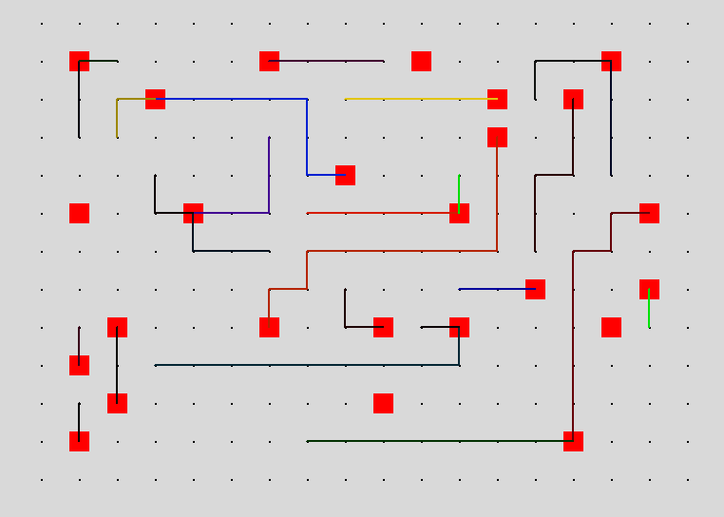
Visualization

Slide 6
Routes
Class Routes
Start and finish coordinate
Go left, right, up or down
If step collides with gate try another step
Layers
Go down when lines cross

Slide 7
Algorithms?
If route crosses another move it down a layer
best about 13 layers
Move down at the cross
best 10 layers with some crosses (??)
Move the lines down in quadrants
More ideas?

